Slide 1
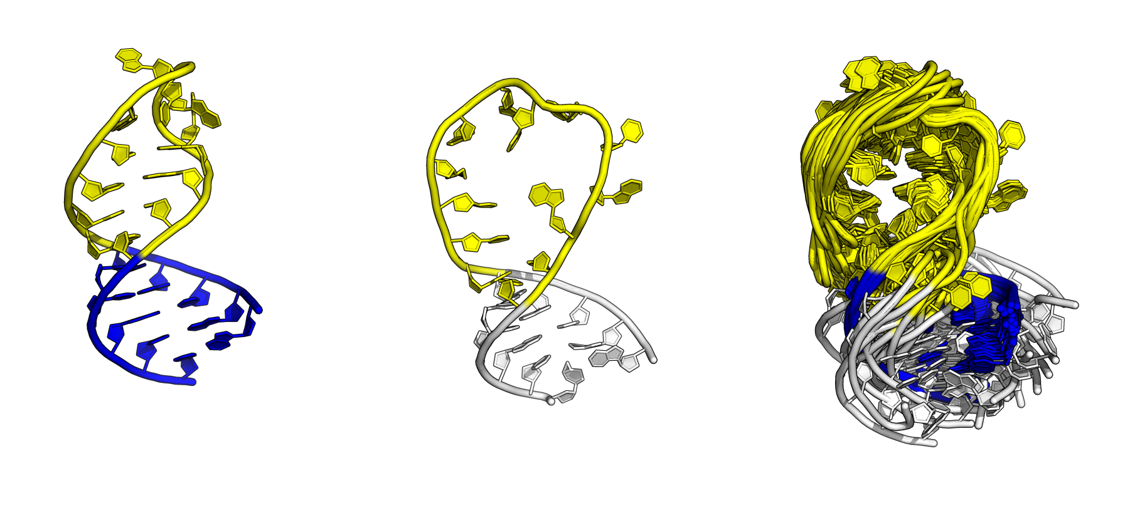
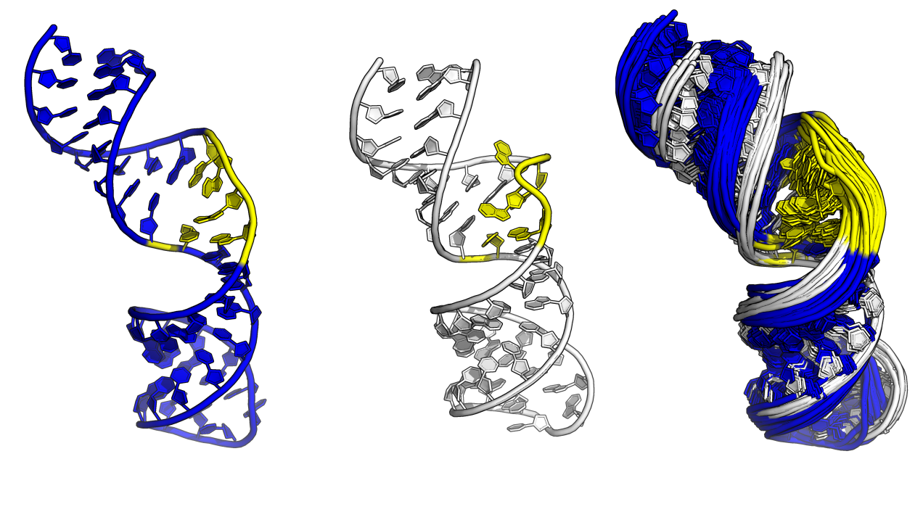
(a)
(b)
(c)
✗
✗
✗
MAE
Free
✗
✗
✗
RMSE
✗
✗
✗
MAE
Bound
✗
✗
✗
RMSE
carbon
proton
both
(d)
(e)
(f)
✗
✗
✗
MAE
(c)
Free
✗
✗
✗
RMSE
✗
✗
✗
MAE
Bound
✗
✗
✗
RMSE
carbon
proton
both
0.50
NSLR
1.00

Slide 2
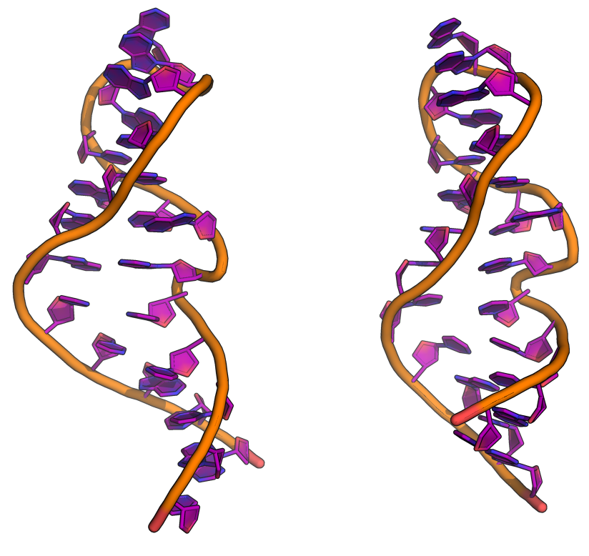
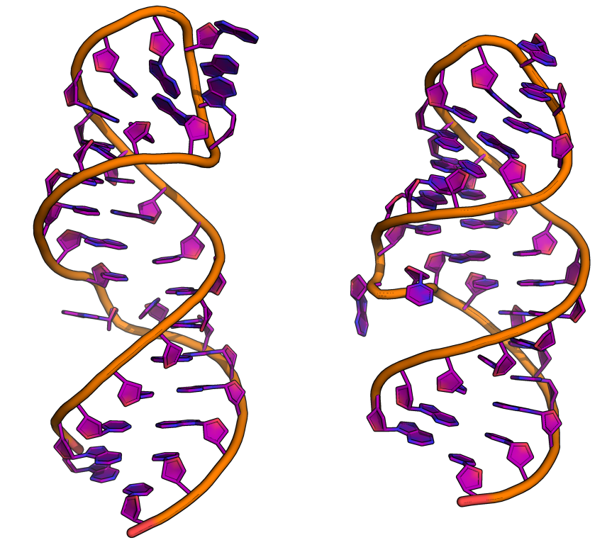
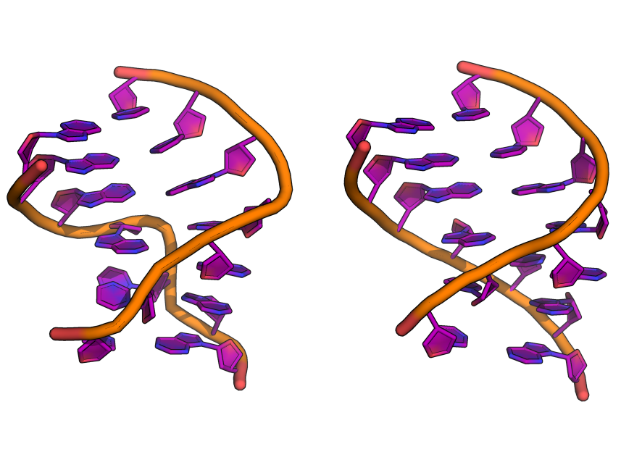
NMR
X-RAY
a
b
c
✔
Consensus
1SCL (1.24)
430D (1.18)
28SR (1.47)
1LNT (1.44)
2LPS (0.79)
1KXK (0.98)
RAMSEY
(1.38)
(1.34)
(1.50)
(1.52)
(0.97)
(1.10)
LARMOR^{D}
(1.27)
(1.29)
(1.78)
(1.57)
(0.83)
(1.04)

Slide 3
NMR
X-RAY
NMR
X-RAY
NMR
X-RAY
a
b
c
1SCL (2.88)
430D (2.75)
28SR (1.47)
1LNT (1.44)
2LPS (0.86)
1KXK (1.07)

Slide 4
a
b
Resolving Power (NSLR)
Resolving Power (NSLR)
1
2
3
4
5
6
7
8
¹H
¹³C
¹H+ ¹³C
test
nuclei

Slide 5
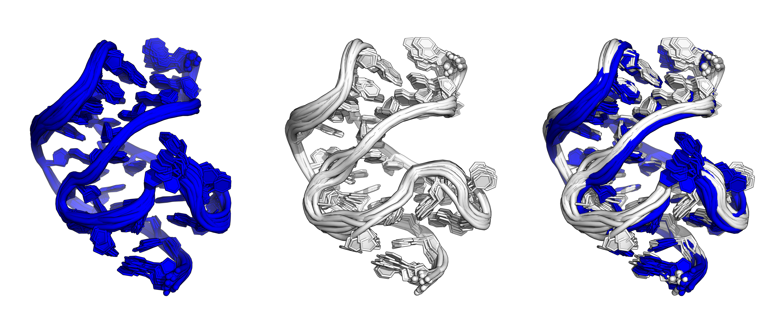
Compare Observed and Computed Chemical Shifts
Error = 0.67
(Higher Quality)
✗
comp. chemical shifts (ppm)
comp. chemical shifts (ppm)
2KFC
obs. chemical shifts (ppm)
obs. chemical shifts (ppm)
Error = 0.67
(Higher Quality)
✔
comp. chemical shifts (ppm)
comp. chemical shifts (ppm)
2L1V
obs. chemical shifts (ppm)
obs. chemical shifts (ppm)

Slide 6
Computed Chemical Shifts From 3D Structure
Compare
Observed and Computed Chemical Shifts
¹H
¹³C
Error =1.90
(Higher Quality)
✗
comp. chemical shifts (ppm)
comp. chemical shifts (ppm)
outdated
obs. chemical shifts (ppm)
obs. chemical shifts (ppm)
Error = 1.88
(Higher Quality)
✔
comp. chemical shifts (ppm)
comp. chemical shifts (ppm)
updated
obs. chemical shifts (ppm)
obs. chemical shifts (ppm)

Slide 7
Consensus
 | Average Structure (¹H, ¹³C, ¹H +¹³C) | Conformationally Averaged (¹H, ¹³C, ¹H +¹³C) | Each Model (¹H, ¹³C, ¹H +¹³C)
(1) 1R2P:2LPS | ✔, ✔, ✔ | ✔, ✔, ✔ | ✔, ✔, ✔
(2) 2FRL:2M22 | ✔, ✔, ✔ | ✔, ✔, ✔ | ✔, ✔, ✔
(3) 2HX2:2M21 | ✔, ✔, ✔ | ✔, ✗, ✔ | ✔, ✗, ✔
(4) 2KFC:2L1V | ✗, ✔, ✔ | ✗, ✔, ✔ | ✔, ✔, ✔
(5) 2L94:1Z2J | ✗, ✔, ✔ | ✗, ✗, ✗ | ✗, ✗, ✗
(6) 2N82:2N7X | ✔, ✔, ✔ | ✔, ✔, ✔ | ✔, ✔, ✔
(7) 1Z2J:2L94 | ✗, ✔, ✔ | ✔, ✔, ✔ | ✔, ✔, ✔
(8) 2N7X:2N82 | ✗, ✗, ✗ | ✔, ✔, ✔ | ✔, ✔, ✔
True-Positive Rates: | 4/8, 7/8, 7/8 | 6/8, 6/8, 7/8 | 7/8, 6/8, 7/8

Slide 8
Consensus
 | Average Structure ¹H ¹³C ¹H +¹³C | Conformationally Averaged ¹H ¹³C ¹H +¹³C | Each Model ¹H ¹³C ¹H +¹³C
(1) 1R2P:2LPS | ◉   | ◉   | ◉  
(2) 2FRL:2M22 | ◉   | ◉   | ◉  
(3) 2HX2:2M21 | ◉   | ◉   | ◉  
(4) 2KFC:2L1V | ○   | ○   | ◉  
(5) 2L94:1Z2J | ○   | ○   | ○  
(6) 2N82:2N7X | ◉   | ◉   | ◉  
(7) 1Z2J:2L94 | ○   | ◉   | ◉  
(8) 2N7X:2N82 | ○   | ◉   | ◉  
True-Positive Rates: | 4/8 7/8 7/8 | 6/8 6/8 7/8 | 7/8 6/8 7/8

Slide 9
RAMSEY
 | Average Structure (¹H, ¹³C, ¹H +¹³C) | Conformationally Averaged (¹H, ¹³C, ¹H +¹³C) | Each Model (¹H, ¹³C, ¹H +¹³C)
(1) 1R2P:2LPS | ✔, ✔, ✔ | ✔, ✔, ✔ | ✔, ✔, ✔
(2) 2FRL:2M22 | ✔, ✔, ✔ | ✔, ✔, ✔ | ✔, ✔, ✔
(3) 2HX2:2M21 | ✗, ✔, ✔ | ✗, ✔, ✔ | ✗, ✗, ✔
(4) 2KFC:2L1V | ✗, ✔, ✔ | ✔, ✔, ✔ | ✔, ✔, ✔
(5) 2L94:1Z2J | ✗, ✔, ✗ | ✔, ✗, ✗ | ✔, ✗, ✗
(6) 2N82:2N7X | ✔, ✔, ✔ | ✔, ✔, ✔ | ✔, ✔, ✔
(7) 1Z2J:2L94 | ✗, ✔, ✗ | ✗, ✔, ✔ | ✗, ✔, ✔
(8) 2N7X:2N82 | ✗, ✗, ✗ | ✔, ✔, ✔ | ✔, ✔, ✔
True-Positive Rates: | 3/8, 7/8, 5/8 | 6/8, 7/8, 7/8 | 6/8, 6/8, 7/8

Slide 10
LARMOR^{D}
 | Average Structure (¹H, ¹³C, ¹H +¹³C) | Conformationally Averaged (¹H, ¹³C, ¹H +¹³C) | Each Model (¹H, ¹³C, ¹H +¹³C)
(1) 1R2P:2LPS | ✔, ✔, ✔ | ✔, ✔, ✔ | ✔, ✔, ✔
(2) 2FRL:2M22 | ✗, ✔, ✗ | ✔, ✔, ✔ | ✔, ✔, ✔
(3) 2HX2:2M21 | ✔, ✔, ✔ | ✗, ✗, ✗ | ✔, ✗, ✔
(4) 2KFC:2L1V | ✗, ✔, ✗ | ✗, ✔, ✗ | ✗, ✔, ✗
(5) 2L94:1Z2J | ✔, ✔, ✔ | ✗, ✗, ✗ | ✗, ✗, ✗
(6) 2N82:2N7X | ✔, ✔, ✔ | ✗, ✔, ✔ | ✗, ✔, ✔
(7) 1Z2J:2L94 | ✔, ✔, ✔ | ✔, ✔, ✔ | ✔, ✗, ✔
(8) 2N7X:2N82 | ✗, ✗, ✗ | ✔, ✔, ✔ | ✔, ✔, ✔
True-Positive Rates: | 5/8, 7/8, 5/8 | 4/8, 6/8, 5/8 | 5/8, 5/8, 6/8

Slide 12
a
b
c
Resolving Power (NSLR)
Resolving Power (NSLR)
1
2
3
4
5
6
7
8
¹H
¹³C
¹H+ ¹³C
test
nuclei

Slide 14
a
Consensus
b
Resolving Power (NSLR)
Resolving Power (NSLR)
1
2
3
4
5
6
7
8
¹H
¹³C
¹H+ ¹³C
test
nuclei
c
RAMSEY
d
Resolving Power (NSLR)
Resolving Power (NSLR)
1
2
3
4
5
6
7
8
¹H
¹³C
¹H+ ¹³C
test
nuclei
e
LARMOR^{D}
f
Resolving Power (NSLR)
Resolving Power (NSLR)
1
2
3
4
5
6
7
8
¹H
¹³C
¹H+ ¹³C
test
nuclei

Slide 15
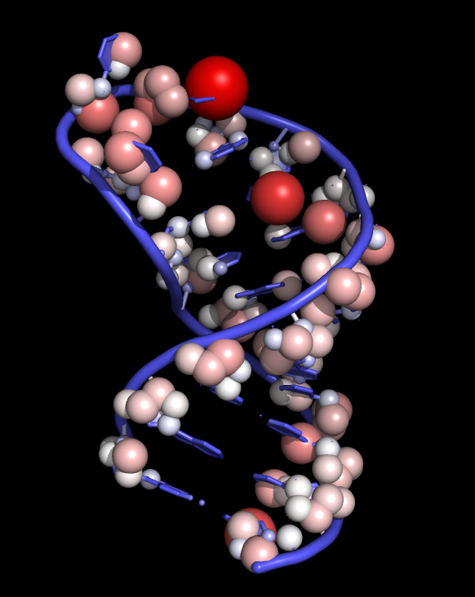
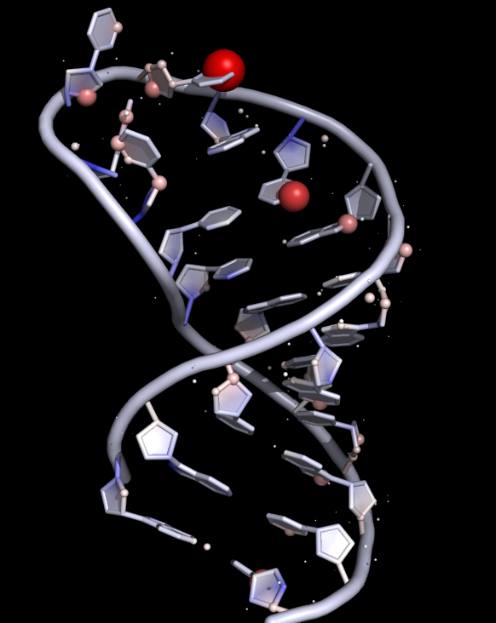
A
original
B
re-referenced

Slide 16
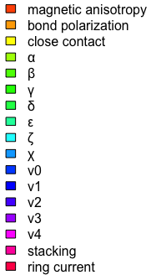
a
Consensus
b
RAMSEY
c
LARMOR^{D}

Slide 17
a
Consensus
b
RAMSEY
c
LARMOR^{D}

Slide 19
LARMOR^{D}
RAMSEY
Consensus

